Slide 1
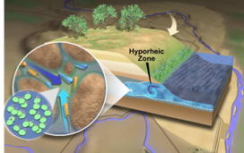
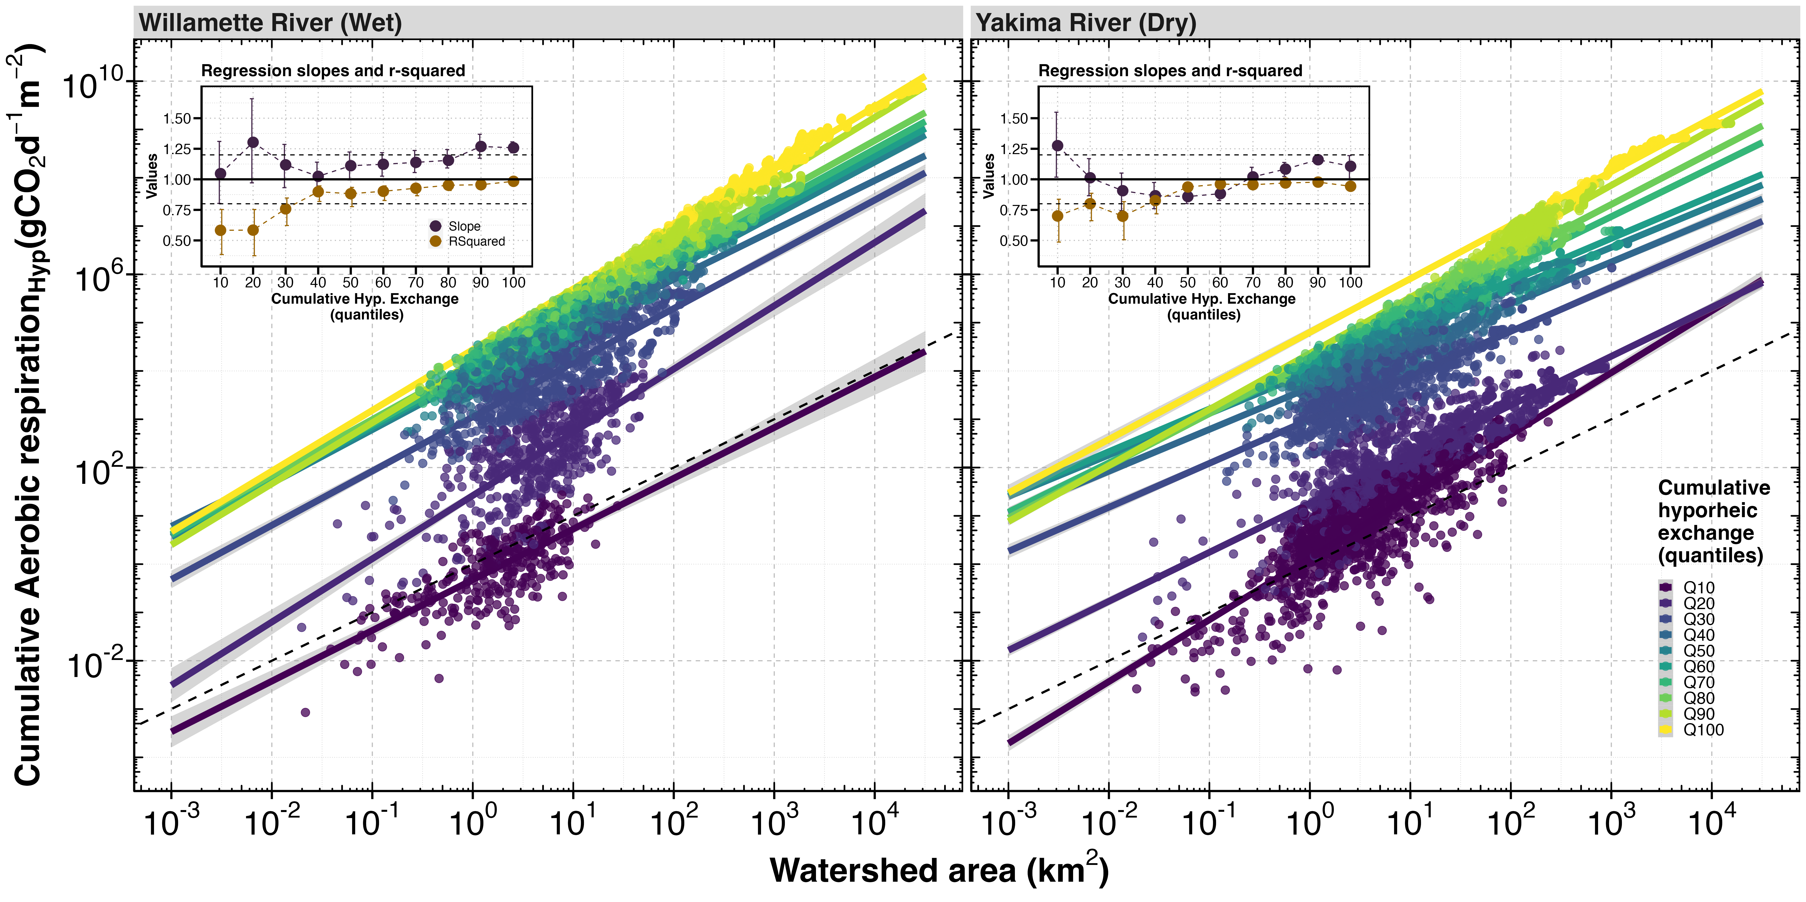
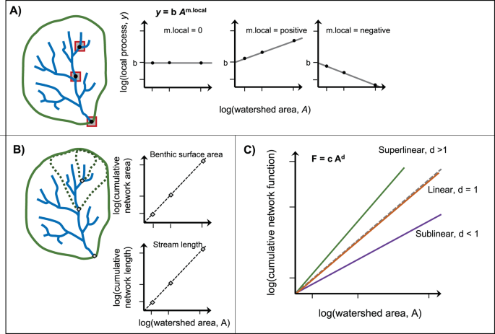
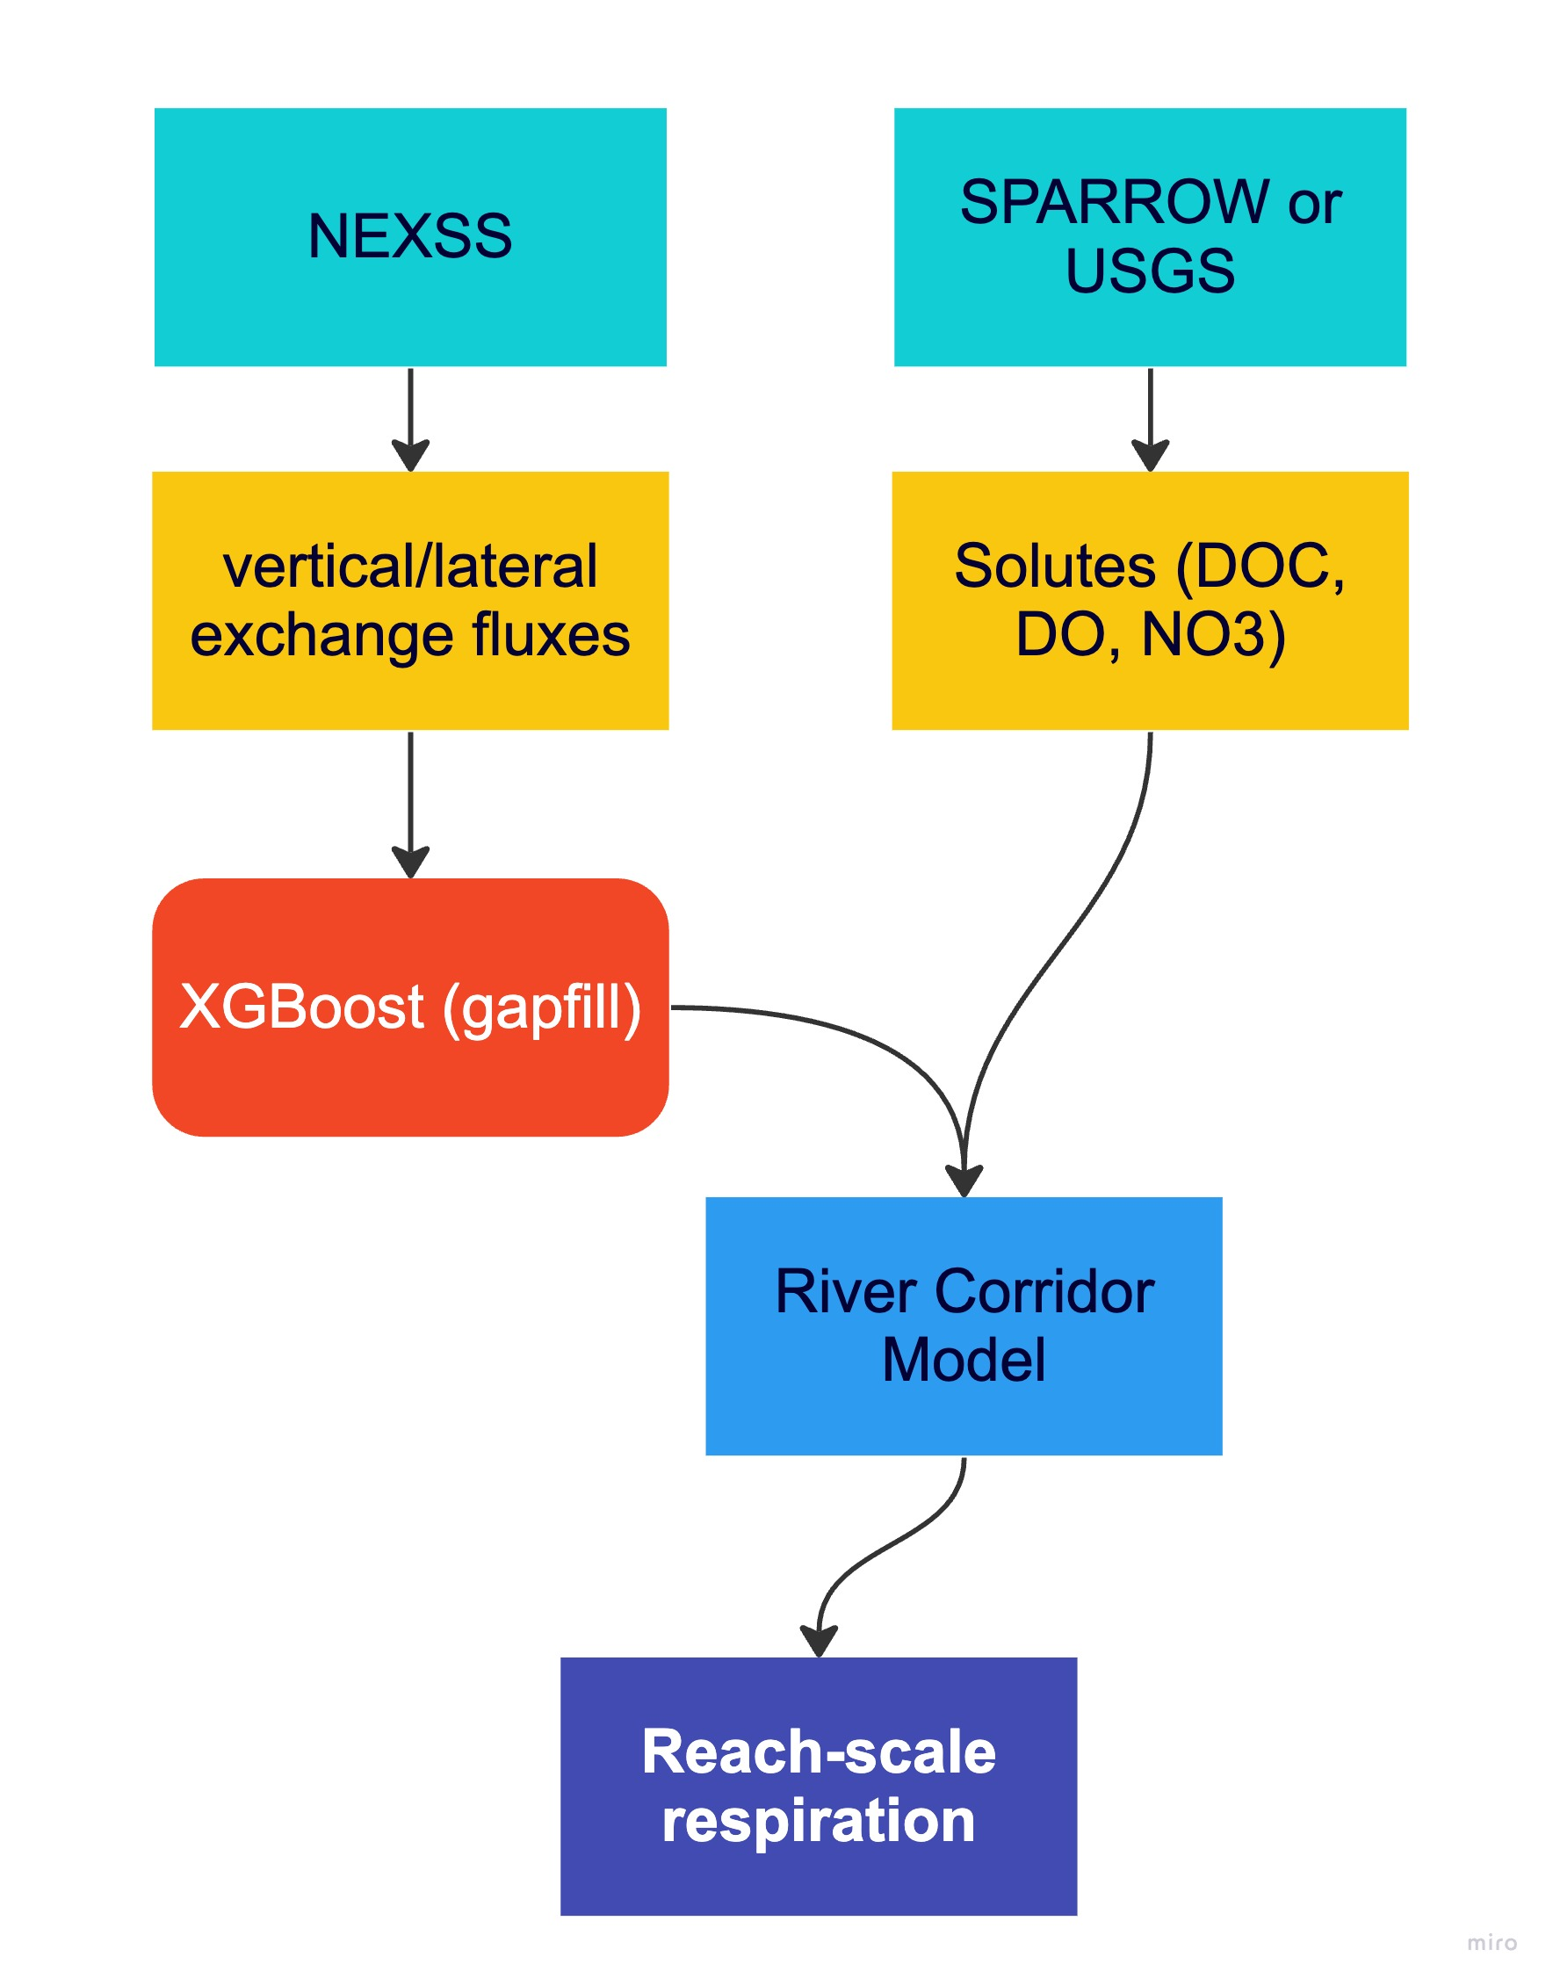
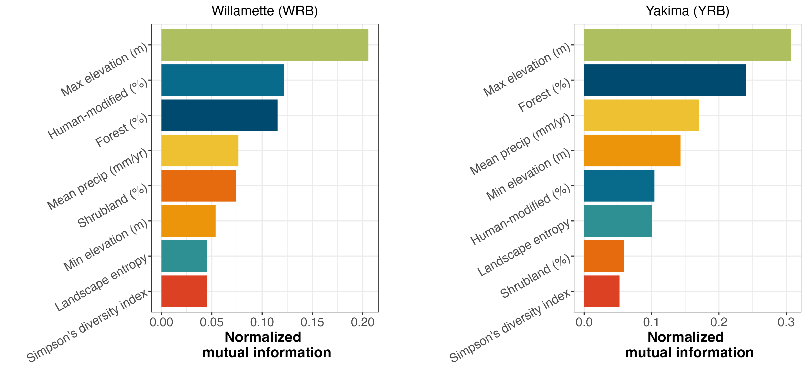
Allometric scaling of hyporheic respiration across contrasting basins in the Pacific Northwest, USA
Francisco Guerroro¹, Peter Regier², Kyongho Son³, Xingyuan Chen³, Yilin Fang³, Peishi Jiang³, Micah Taylor³, Wilfred Wollheim⁴, Tim Scheibe³ and James Stegen³
1. Oregon State University, Corvallis, OR, USA, 2. Marine and Coastal Research Lab, Pacific Northwest National Laboratory, Richland, WA, USA, 3. Pacific Northwest National Laboratory, Richland, WA, USA, 4. University of New Hampshire, Durham, NH, USA.
Background and Motivation
Allometric Scaling
Hyporheic zones (the interface between surface and groundwater) in river corridors regulate aquatic metabolism. They are temporally dynamic and spatially heterogeneous interfaces, making it difficult to predict hyporheic respiration across scales.
Consistent patterns
Strongest allometric scaling (high R²) at highest hyporheic exchange fluxes
Weakest allometric scaling (low R²) at lower exchange fluxes
Super-linear scaling (slope > 1) at highest exchange fluxes
Need high-res and to attribute source (stole from Tim’s poster)
Allometric scaling (processes that scale with watershed area) provides a framework for scaling watershed processes. Wollheim et al. (2022) showed consistent linear to super-linear allometric scaling of ecosystem respiration with watershed area.
Basin-specific patterns
Sublinear scaling in YRB for mid exchange flux quantiles
Linear scaling: Q40/Q50 in WRB, Q70 in YRB
Questions
Does hyporheic respiration scale allometrically?
Do watershed characteristics influence allometric scaling relationships?
Relating to Ecosystem Characteristics
Consistent relationships
Maximum elevation most closely related to spatial scaling patterns in both basins
% Forest and annual precipitation were top-4 in mutual information
Wollheim et al. (2022) Nat. Comm.
Study Basins
Modeling
Willamette (WRB)
Wetter
Lower elevation
Primarily human and forested landcover
Basin-specific relationships
Super-linear scaling primarily main-stem in YRB, primarily headwaters in WRB
Human-modified land-cover 2nd in mutual information for WRB, 5th for YRB
Yakima (YRB)
Drier
Higher elevation
Primarily shrub and forested landcover
Take-homes
Allometric scaling of hyporheic respiration:
weakest at low exchange fluxes
super-linear at high exchange fluxes
Max. elevation strongest explanation of spatial scaling patterns across both basins
Land-cover and precipitation also relate to spatial scaling patterns, differ by watershed
Notes:
NOTE: This file must print at 200% SCALE to achieve a final print size of 72” wide x 48” tall.
• Contact Digital Duplicating (375-2969, http://digitalduplicating.pnl.gov) to order poster printing and finishing services for your completed poster design.
• Remember to have your poster cleared for public display/distribution through the Information Release system (https://informationrelease.pnl.gov). A text placeholder for your poster’s Clearance Number is included in the footer.

